Slide 1

July 15, 2021
dbt (data build tool) powerful, open-source data transformations

Slide 2
Agenda
Architecture
Overview of dbt
Installation
Transformation
Testing methods
Macros and Freshness
Documentations
DBT command reference

Slide 3
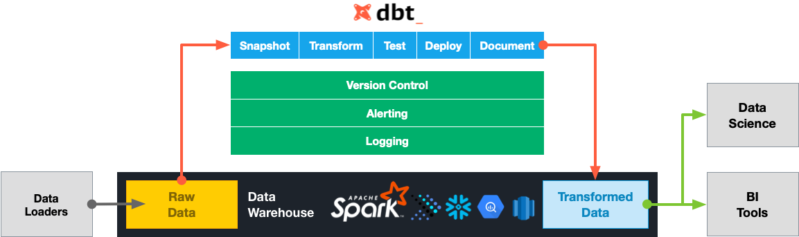
Data Pipeline Architecture

Slide 4
Overview
dbt (data build tool) is an open source, command line based, transformation tool.
dbt does the T in ELT (Extract, Load, Transform) processes.
dbt natively supports connections to Snowflake, BigQuery, Redshift and Postgres data warehouses.
install dbt by pip install dbt
learn more at https://www.getdbt.com

Slide 5
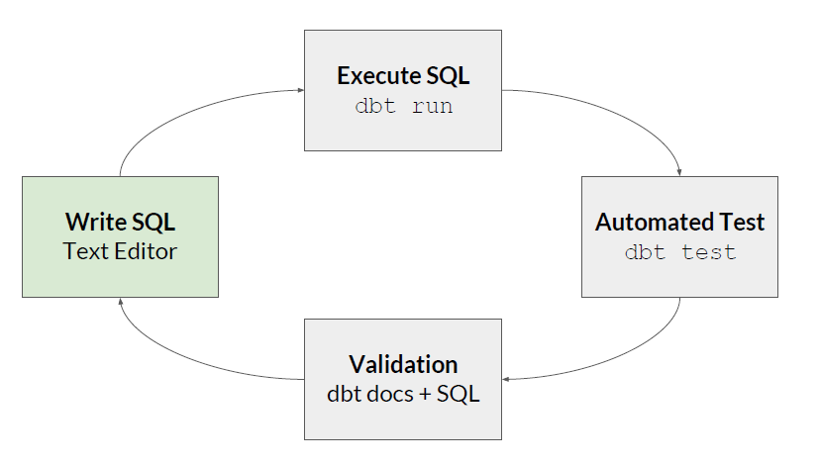
DBT Project
Seeds
Models
Materializations
Tests
Jinja
Macros
Freshness
Documentation

Slide 6

Seeds
Seeds are files in your dbt project (typically in your data directory), that dbt can load into your data warehouse. To load a seed file in your dbt project:
Add the file to your data directory, with a .csv file extension.
Run the dbt command — a new table will be created in your warehouse in your target schema with the seed file name.
Refer to seeds in downstream models.
Seeds are best suited to static data which changes infrequently.

Slide 7
Model
The atomic unit of transformation in dbt is called a model.
A model is a select statement.
Models are defined in .sql files (typically in your models directory)
The name of the file is used as the model's name
Build models in a target schema you define

Slide 8
Materializations
{{config(
materialized='table'
)}}
select
...
from accounts
is rendered to:
CREATE TABLE ... AS (
select
...
from accounts
);
Materializations define how to turn a model into a warehouse object. DBT has some built-in:
Table
View
Incremental
By default, dbt models are materialized as "views".

Slide 9
Tests
In software development, we want automated tests to prevent bugs from hitting production.
In a warehouse context, automated tests can catch things like:
bad calculations
bad joins / fanouts
schema mismatches
dbt provides this functionality via tests of two kinds.

Slide 10
Schema tests (more common)
Schema tests are added as properties for an existing model. DBT ships with the following tests:
unique
not_null
accepted_values
relationships
Data tests
Data tests are select statements that will tell you if each test query in your project passes or fails. Data tests are defined in .sql files, typically in your tests directory.

Slide 11
Macros and Freshness
Macros are pieces of code that can be reused multiple times. They are analogous to "functions" in other programming languages. Macros are defined in .sql files, typically in your macros directory.
A freshness block is used to define the acceptable amount of time between the most recent record, and now, for a table to be considered "fresh". In the freshness block, one or both of warn_after and error_after can be provided.

Slide 12
Jinja
In dbt, you can combine SQL with Jinja, a templating language.
Using Jinja turns your dbt project into a programming environment for SQL, giving you the ability to do things that aren't normally possible in SQL.
Every dbt model defines all its inputs using special Jinja functions called {{ ref() }} and {{ source() }}.
dbt analyzes these to build up a directed acyclic graph (DAG) of your models.

Slide 13

Auto-documentation
dbt ships with a documentation generator which inspects:
● The contents of your project
● The metadata provided in schema.yml files
● The relations in your warehouse
It uses this data to create a fully interactive catalog for your warehouse.
Good documentation for your dbt models will help downstream consumers discover and understand the datasets which you curate for them.
dbt provides a way to generate documentation for your dbt project and render it as a website.

Slide 14
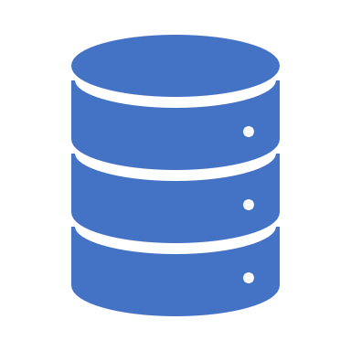
dbt Command reference
debug: debugs dbt connections and projects
init : initializes a new dbt project
compile: compiles (but does not run) the models in a project
run: runs the models in a project
test: executes tests defined in a project
seed: loads CSV files into the database
docs : generates documentation for a project
source: provides tools for working with source data
freshness : calculate freshness snapshots for the source tables

Slide 15



